Slide 1
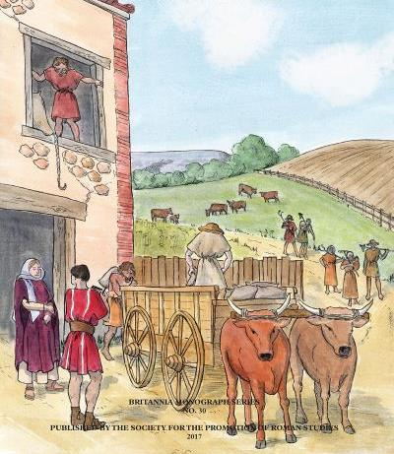
Interpreting plant and animal remains ‘big data’: reflections on the Rural Settlement of Roman Britain project
Dr Martyn Allen (Oxford Archaeology) and Dr Lisa Lodwick (University of Oxford)

Slide 2
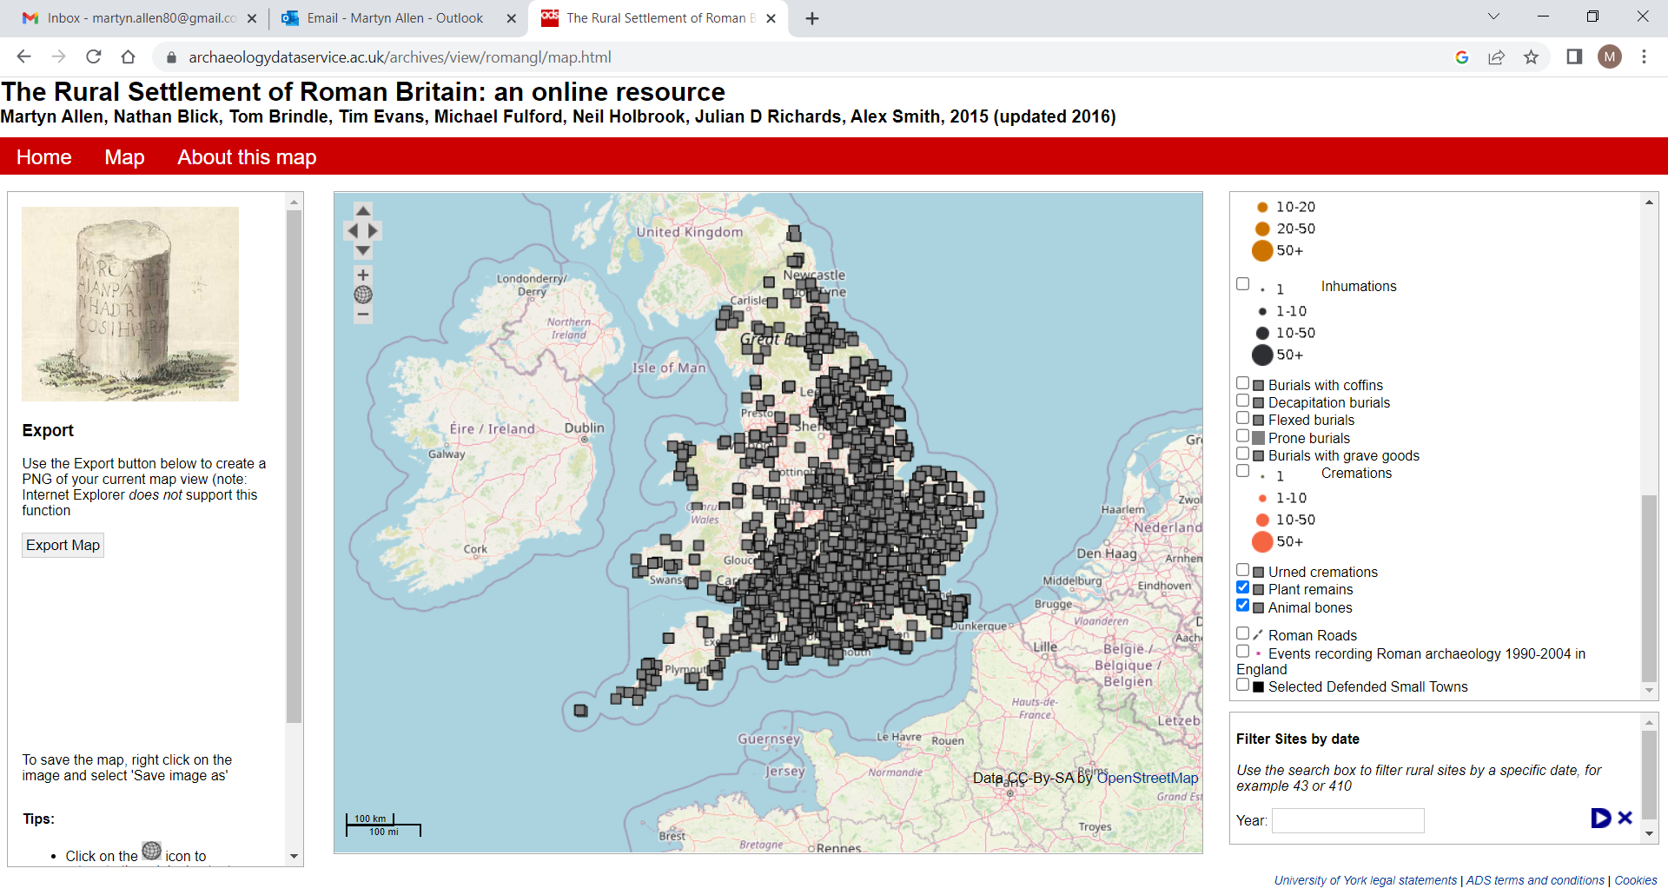
3654 Roman Rural Sites (almost exclusively excavated)
1607 LIA and Roman sites with zooarchaeological remains
943 phased faunal assemblages with 100+ NISP taxa
932 LIA and Roman sites with archaeobotanical remains
1068 phased plant assemblages (no min. sample)

Slide 3
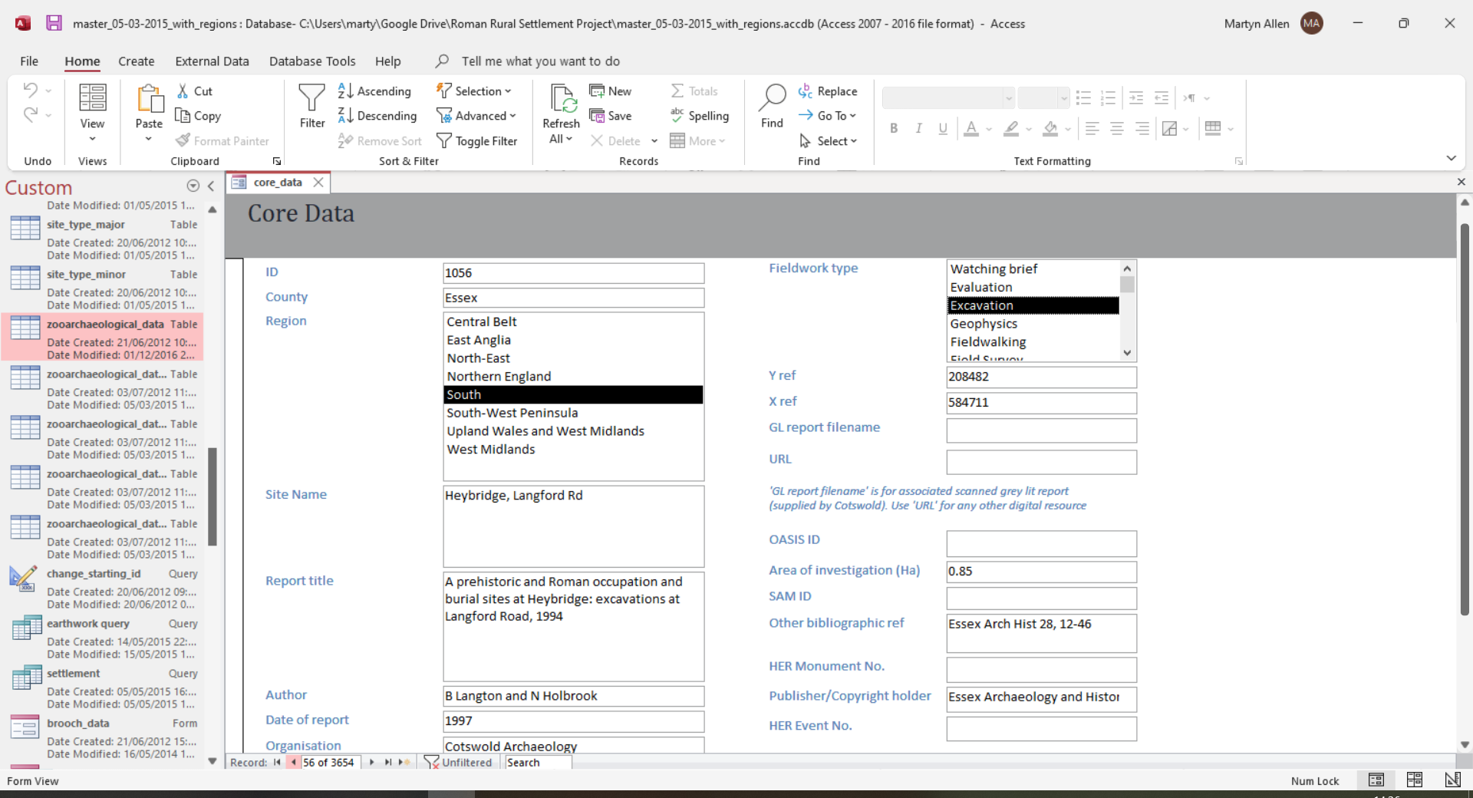
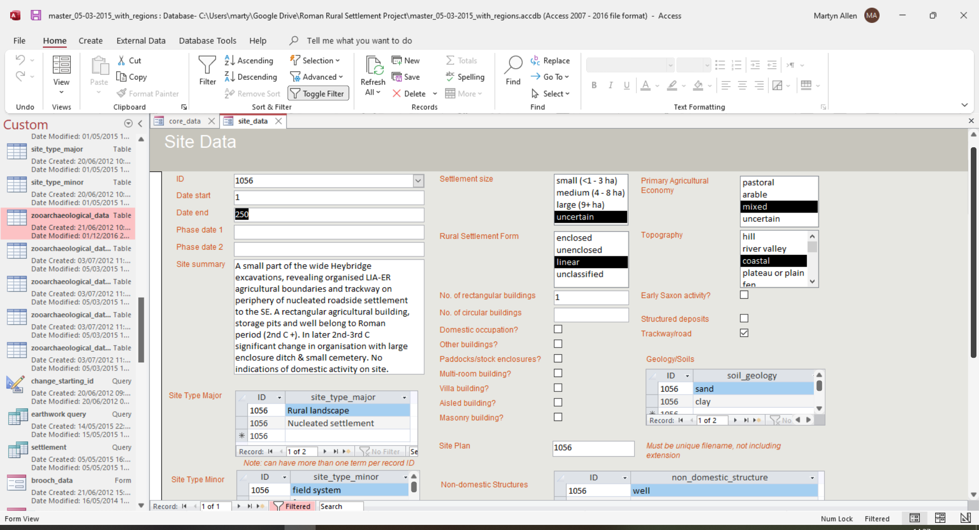
Data collection

Slide 4
Data collection
Site data: Location / Investigation type / Area/ Reference / Links (HER/OASIS)
Settlement data: Dating & phasing / Primary discoveries / Site type / Settlement morphology / Buildings / Topography / Geology
Burials: Inhumation burials / Cremation burials / Disarticulated remains
Artefacts: Coins (detailed) / Brooches (detailed) / other finds (simple)
Faunal remains: Mammal bones / Bird bones / Fish bones / Marine shell / Bird egg shell
Plant remains: Major crops / Minor crops / Indicators (eg malting)

Slide 5
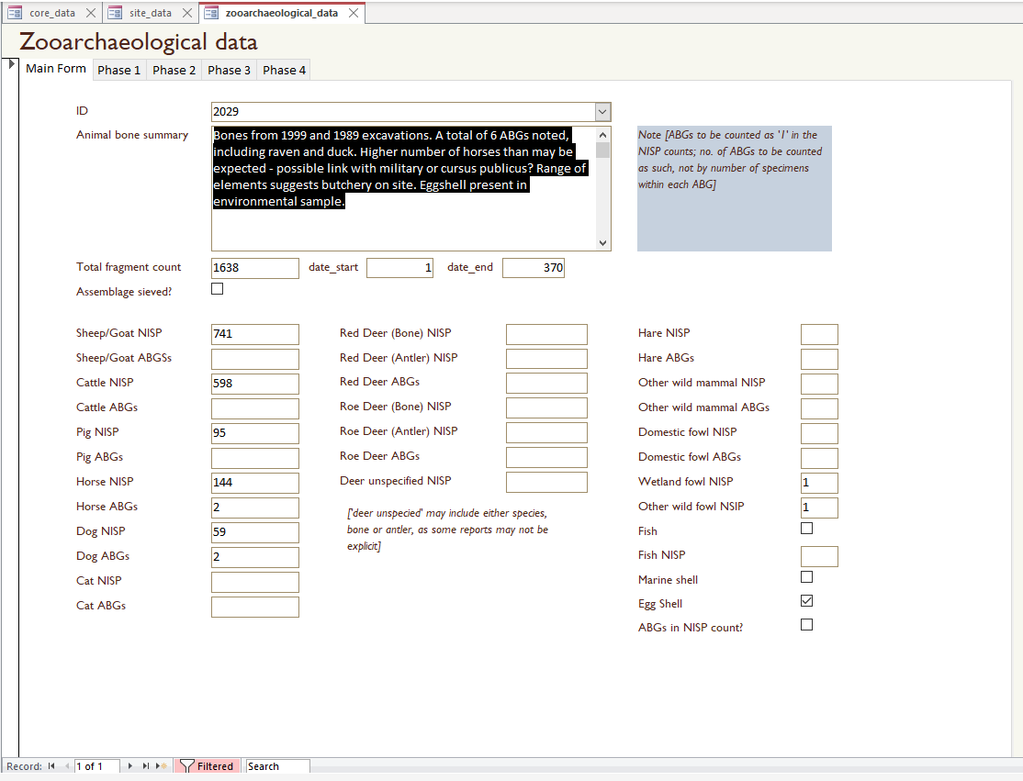
Faunal data
Quantification focussed on NISP for selected taxa
Articulated remains accounted for separately
Fish, marine shell and bird egg shell recorded by presence

Slide 6
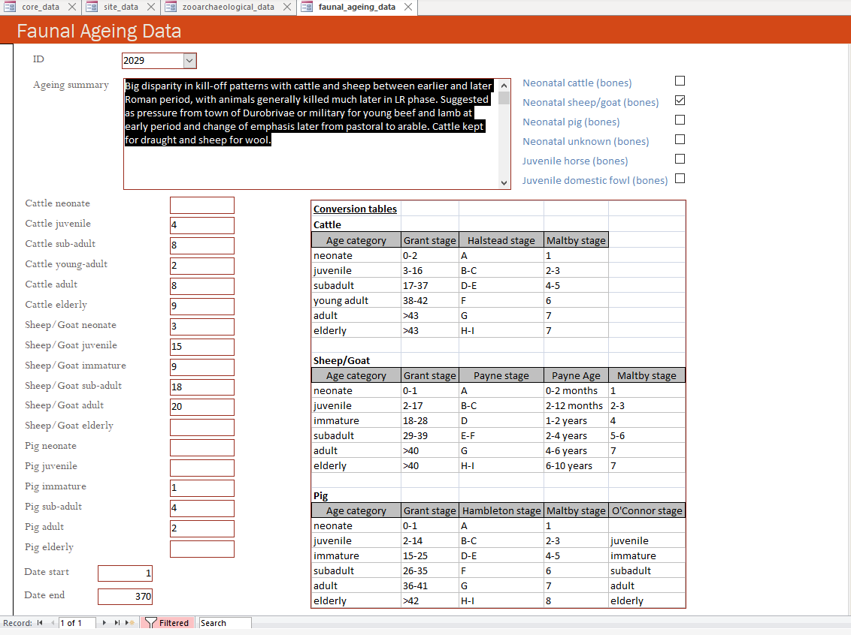
Ageing data
Ageing information focussed on tooth-wear data
Standard conversions used for different recording methods
Presence of neonatal cattle, sheep/goat and pig recorded
Presence of infant/juvenile horse and chicken bones recorded

Slide 7
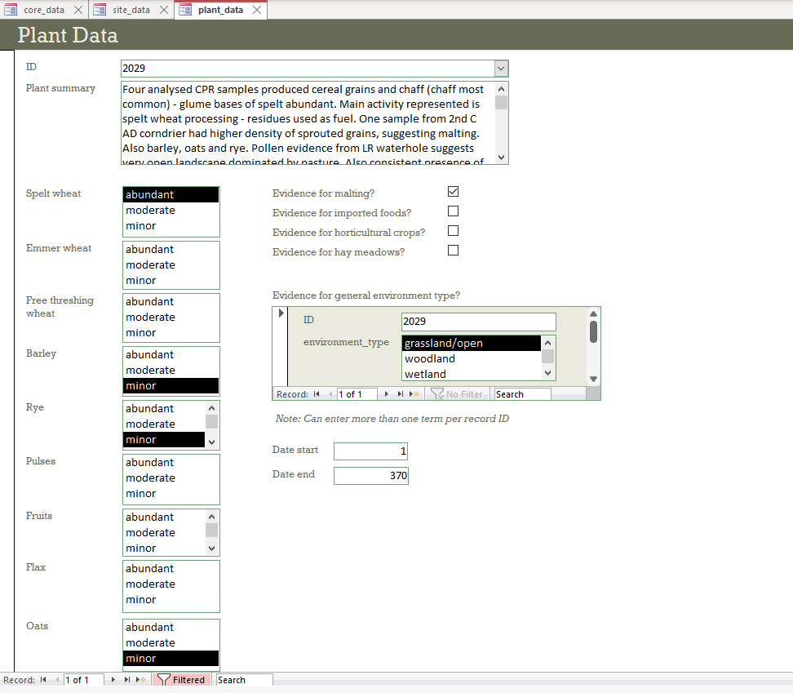
Plant data
Plant data only broadly recorded by relative abundance at the start of the project
Data not suitable for detailed analysis, but entered to provide a basic record
No funding or specialist on-board until year 2

Slide 8
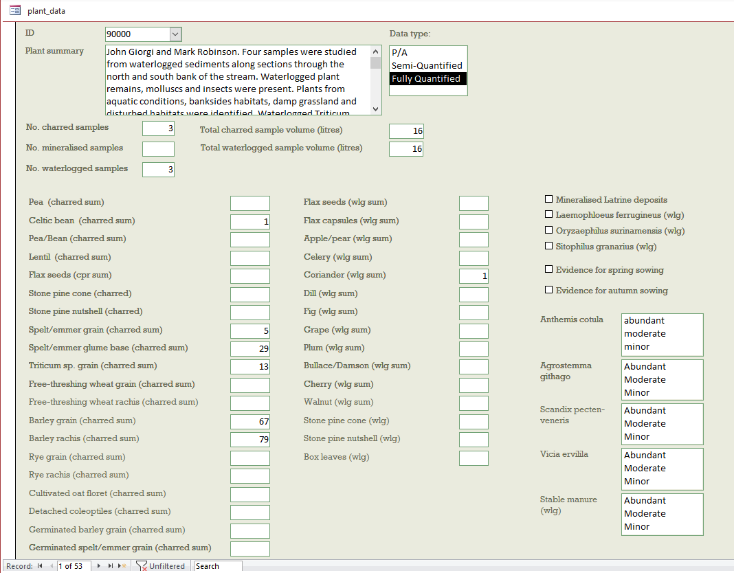
Small towns project: improved plant data
Funding for ‘small towns’ element allowed for more-detailed plant data recording
Taxa and elements recorded by NISP
Other indicators and relative abundance of weed seeds also included

Slide 9
Regional characterisation:
livestock frequencies
Volume 1

Slide 10
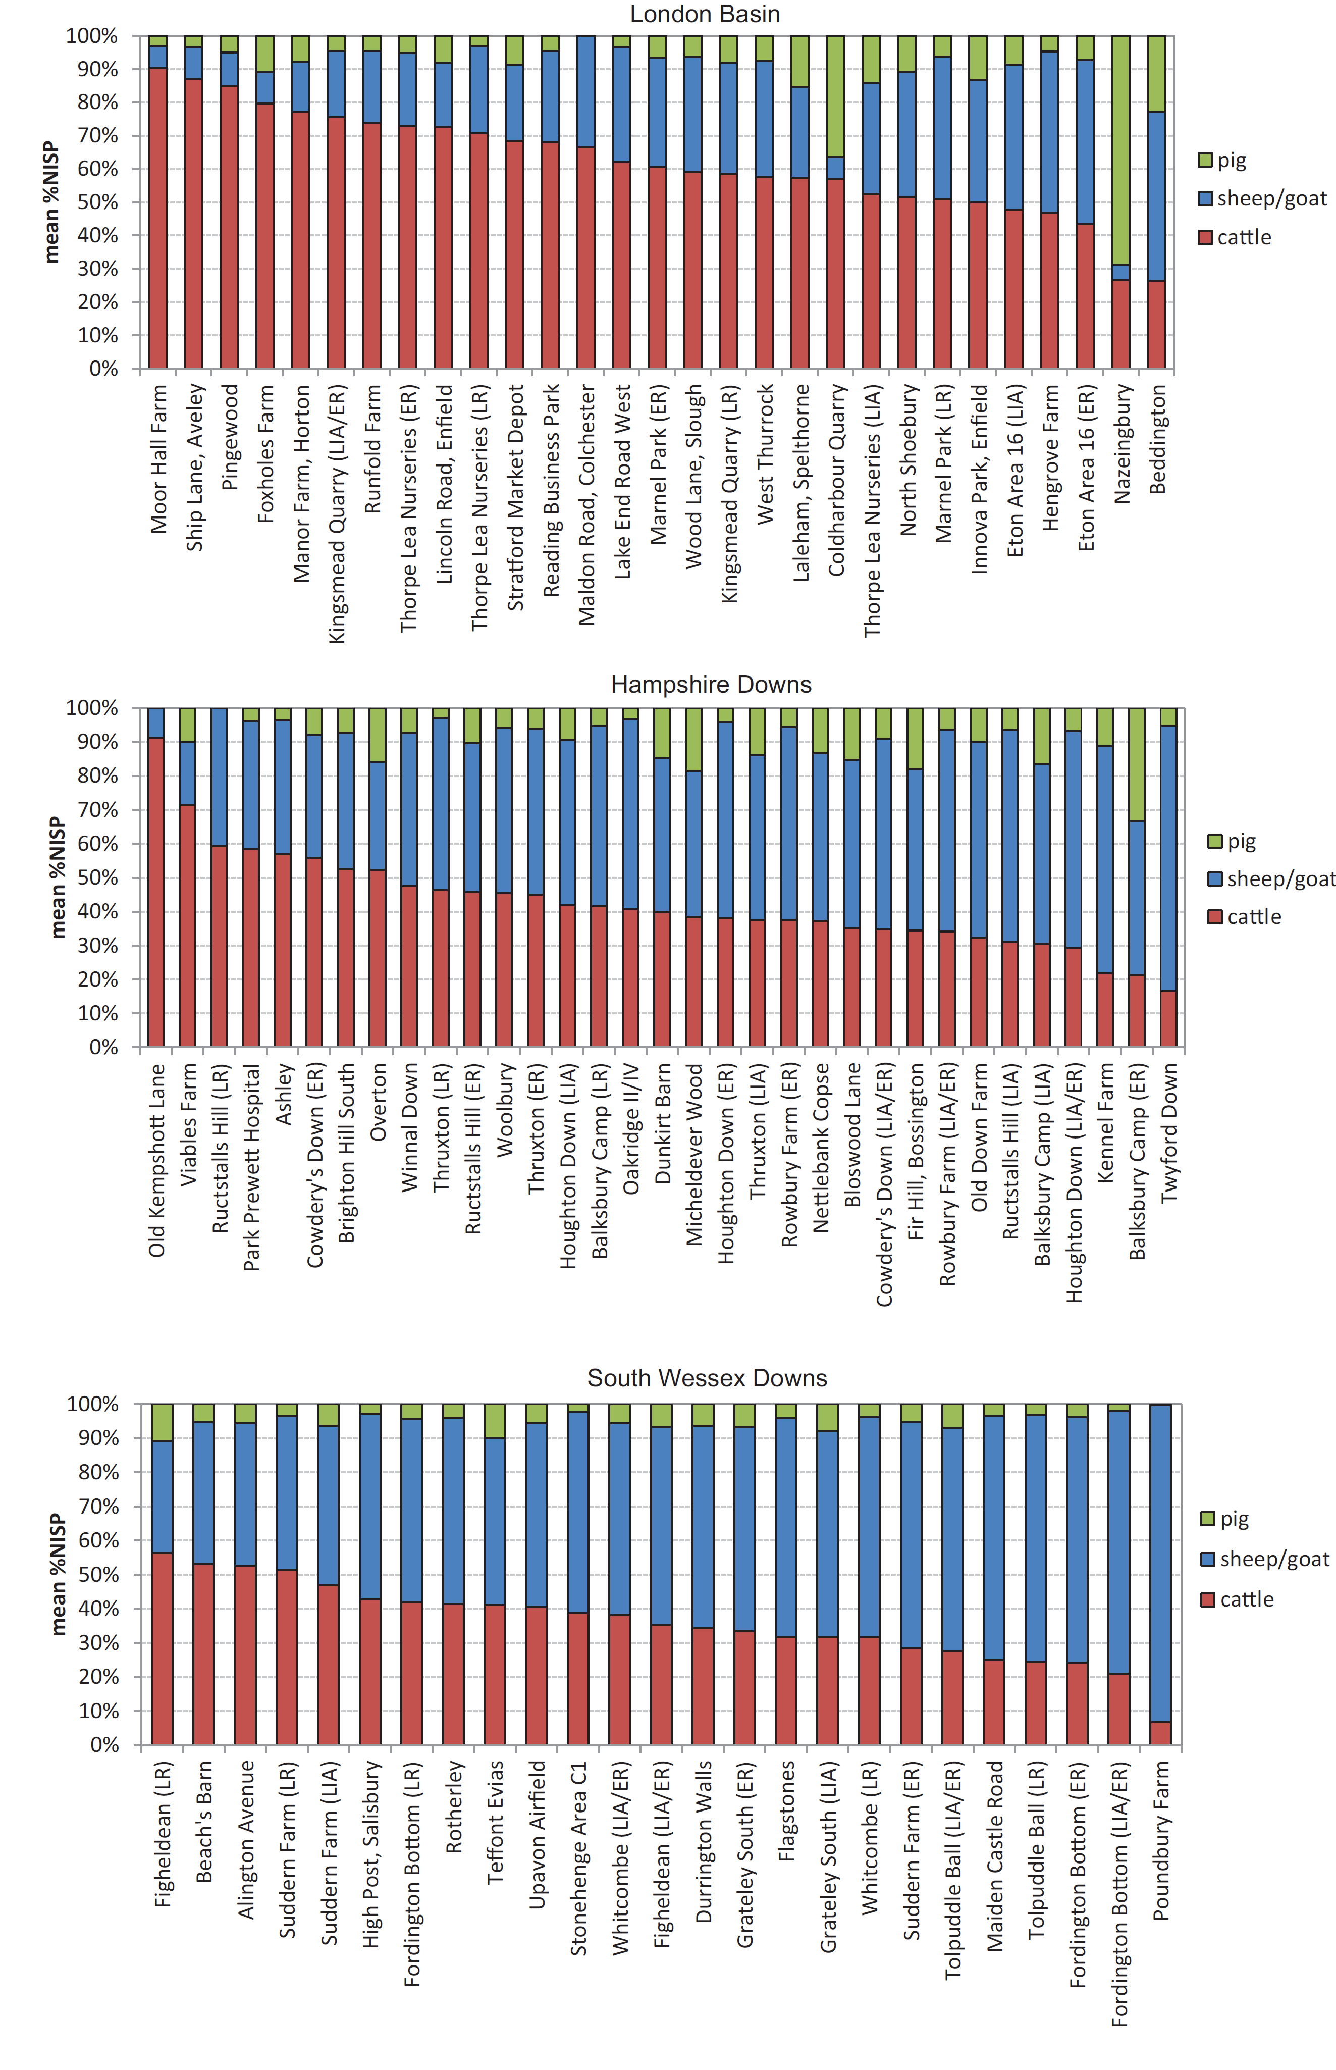
Regional characterisation:
livestock frequencies
Volume 1

Slide 11
Regional characterisation:
crop husbandry
Volume 1

Slide 12
Detailed analysis:
livestock frequencies
cattle
sheep/goat
Volume 2
sites in the London basin region

Slide 13
Detailed analysis:
livestock husbandry
cattle tooth-wear data
Volume 2

Slide 14
Extra data:
biometrics
cattle withers’ heights over time
Volume 2

Slide 15
Detailed analysis:
crop husbandry
Volume 2

Slide 16
Detailed analysis:
seeds, soil and the environment
Volume 2

Slide 17
Detailed analysis:
processing and malting
Suggested incidence of malting
Malt house at Weedon Hill, Aylesbury, Buckinghamshire (Wakeham and Bradley 2013)
Volume 2

Slide 18
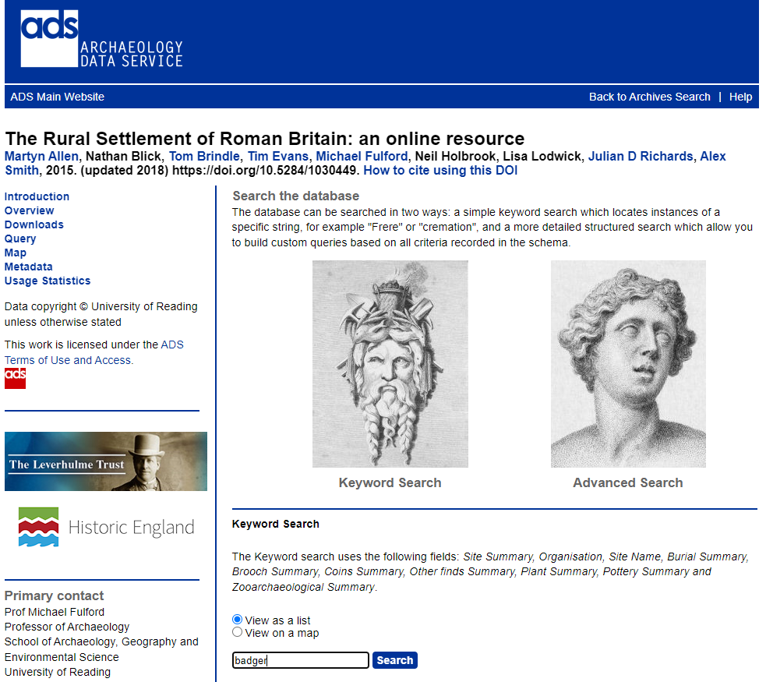
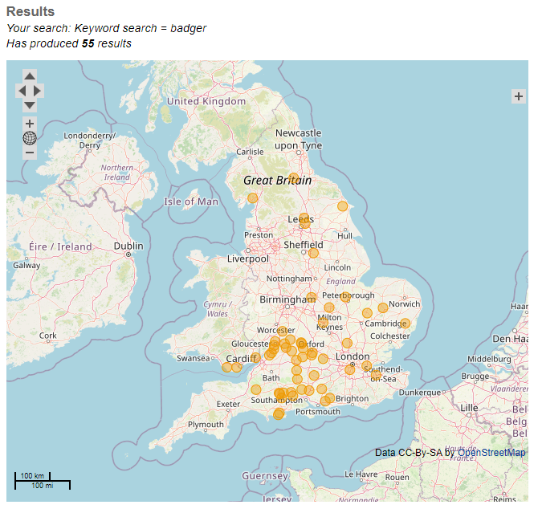
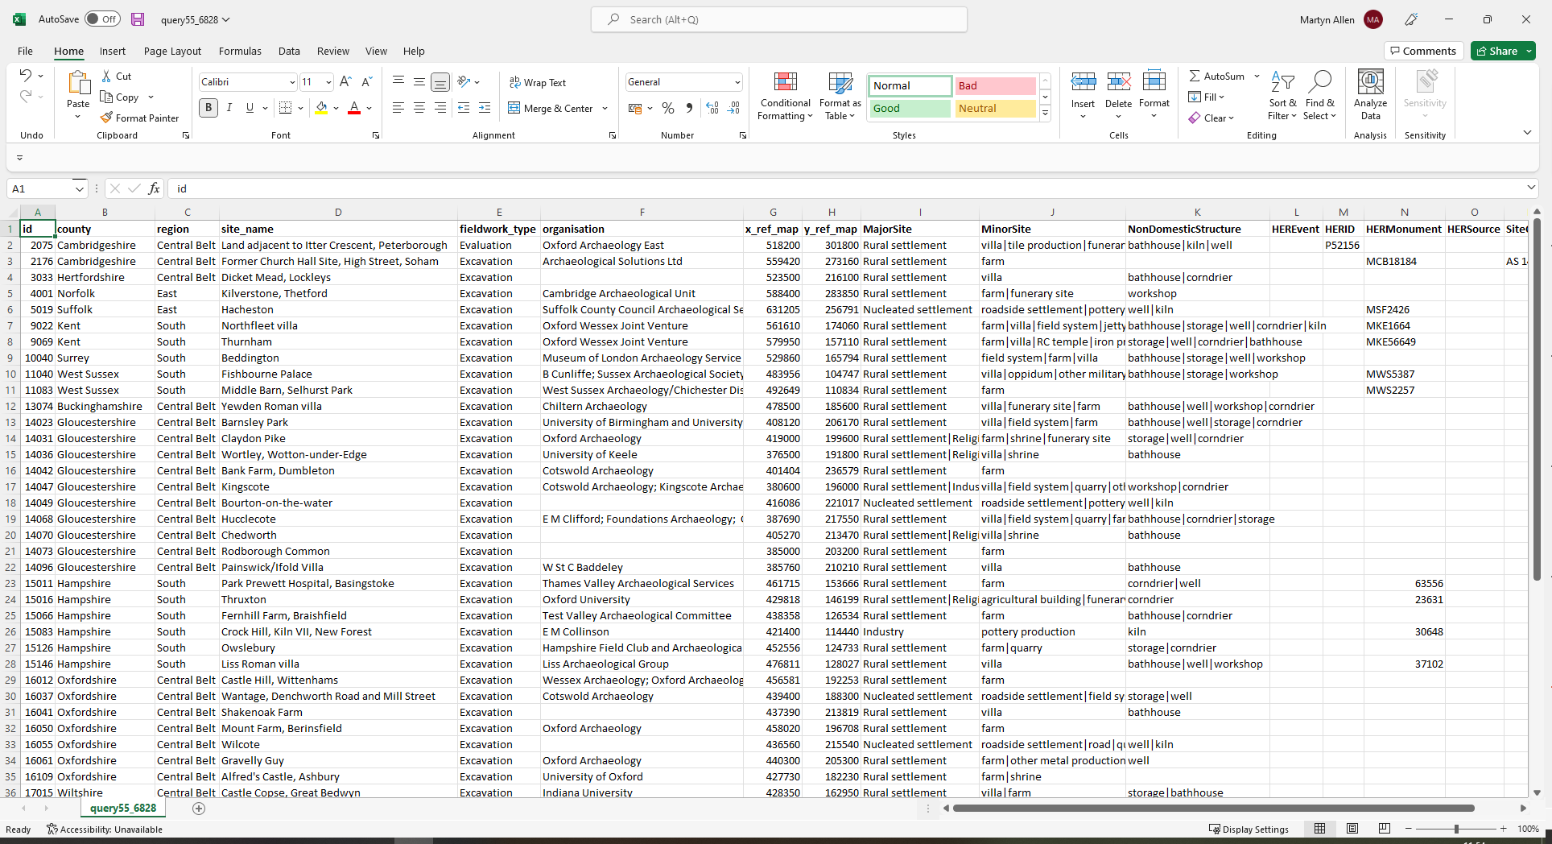
e.g. online search for ‘badger’ results in:
Digital data download
Searchable mapped distribution of sites
Open access data: keyword searches

Slide 19
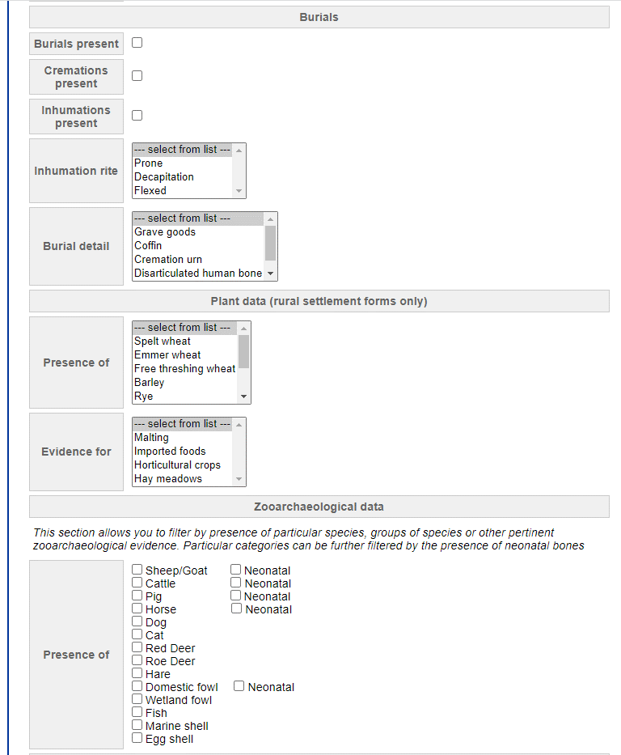
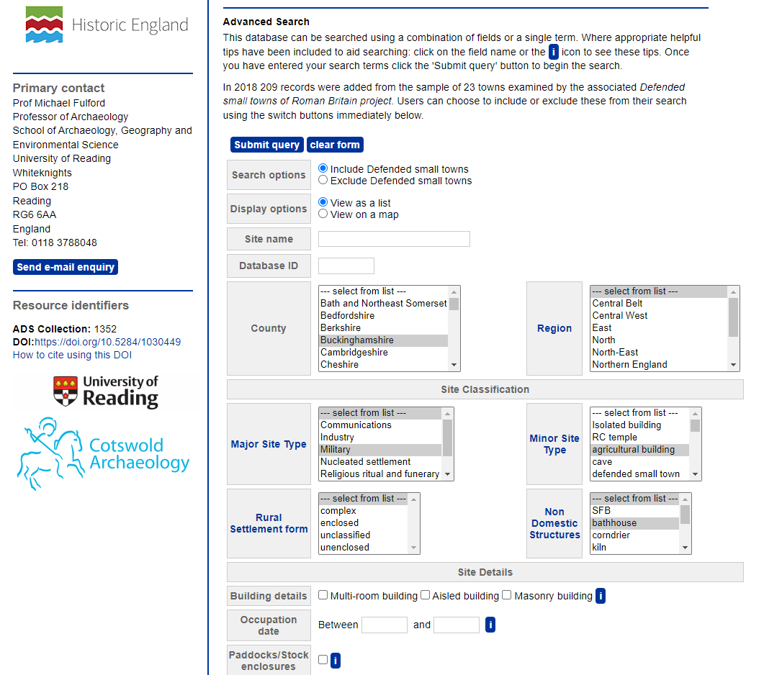
Open access data: advanced searches

Slide 20
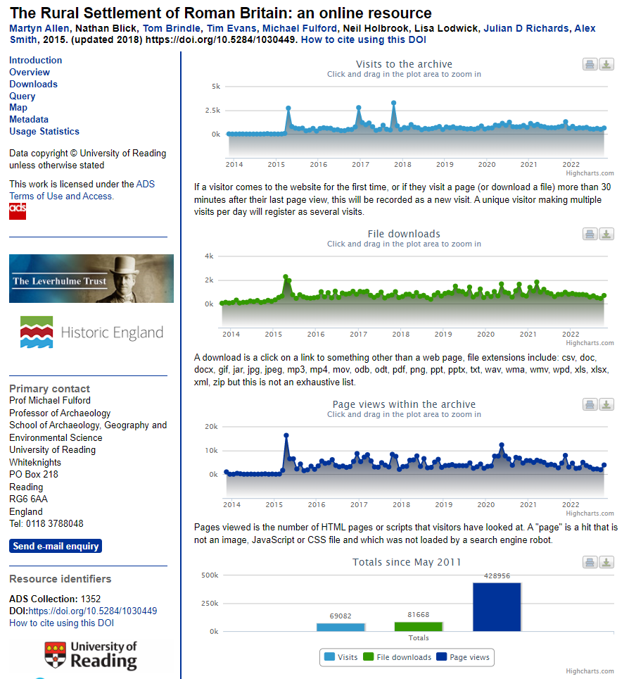
Open access data and the project’s legacy
The online database went live in 2015
In total, the site has received:
c. 70,000 visits
c. 82,000 file downloads
c. 430,000 page views

